Slide 1
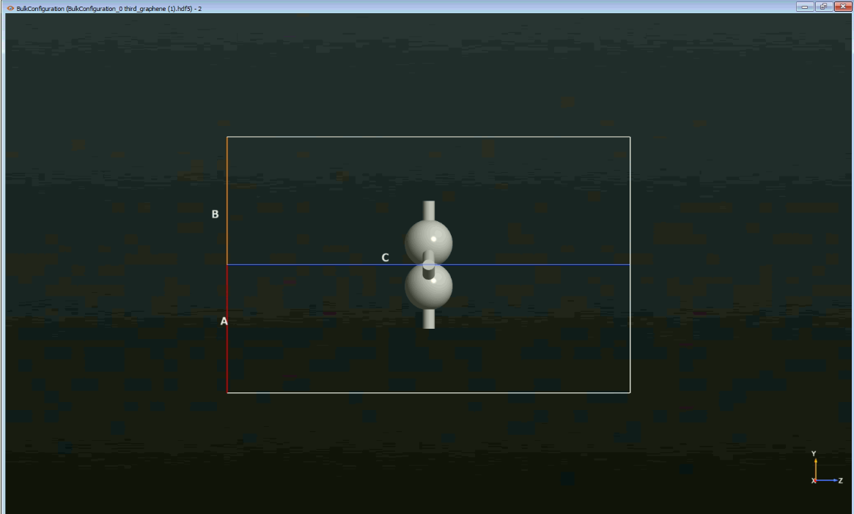

Slide 2
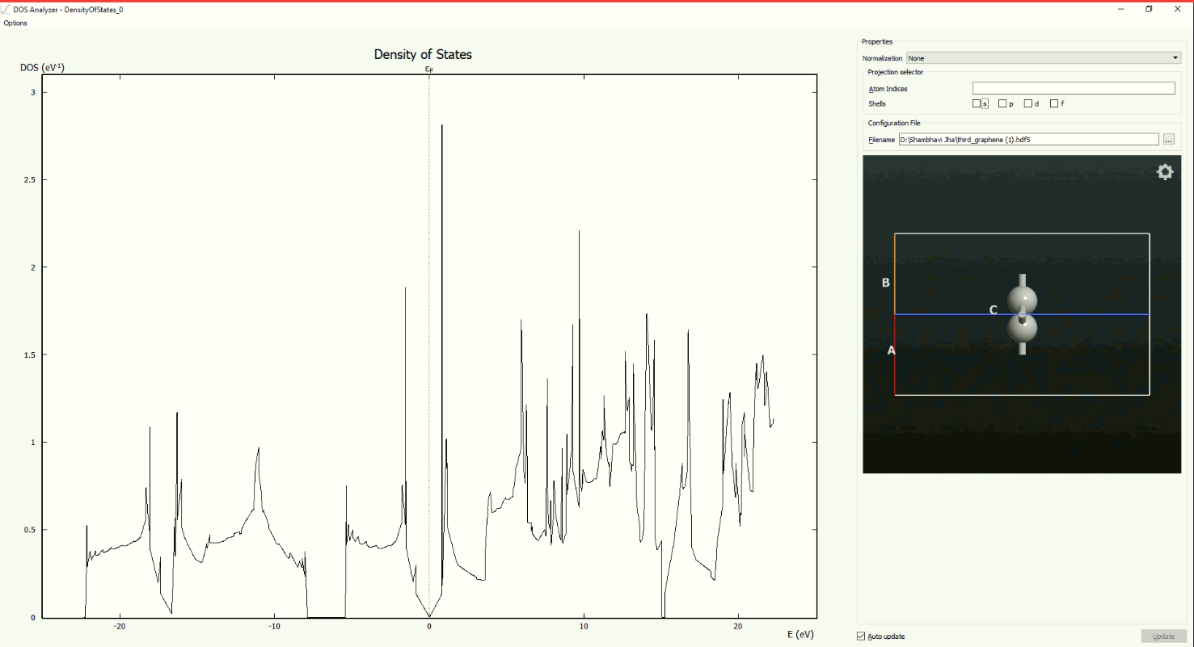
Plot Of Density Of States (all orbitals contribution)

Slide 3
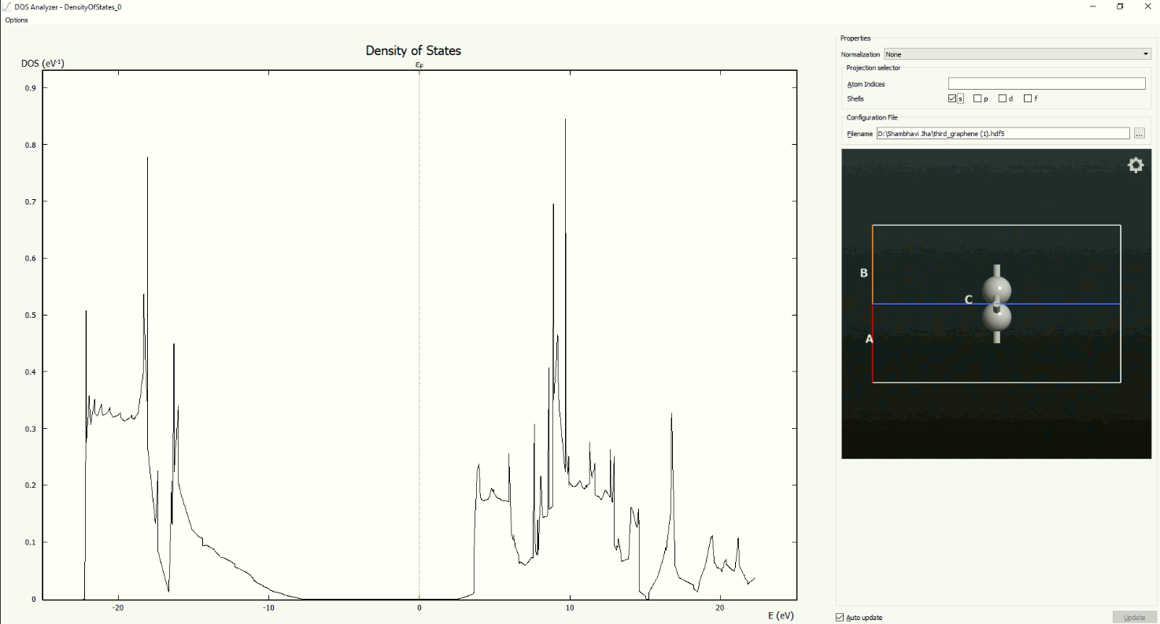
Contribution of s orbital in DOS

Slide 4
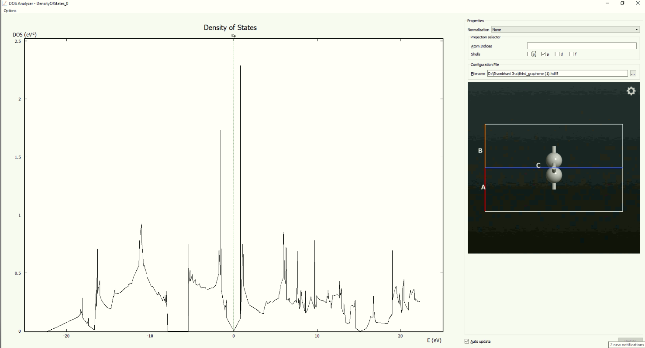
Contribution of p orbitals(px, py, pz) in DOS 1)The p orbitals have the maximum contribution in the formation of the dirac cone. 2)The dirac cone is the cone like structure being formed with its tip at the fermi level.

Slide 5
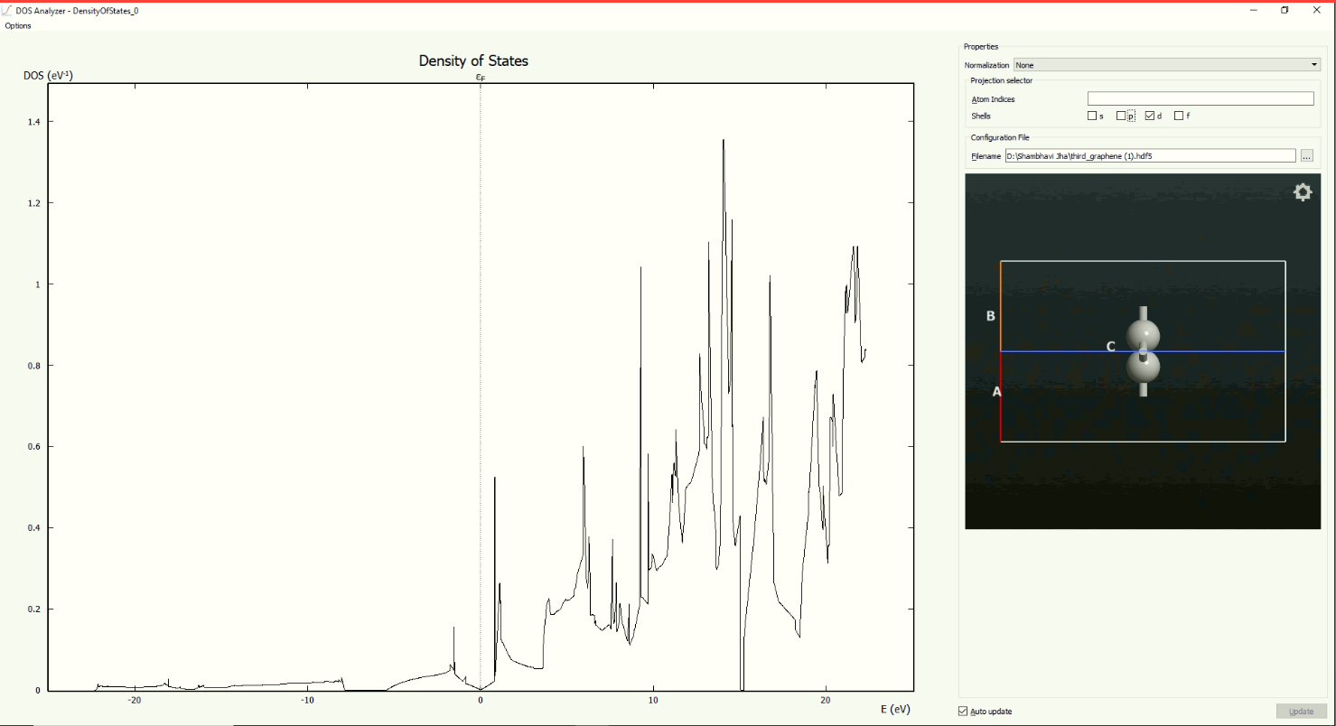
d orbital also has some contribution in the formation of dirac cone

Slide 6
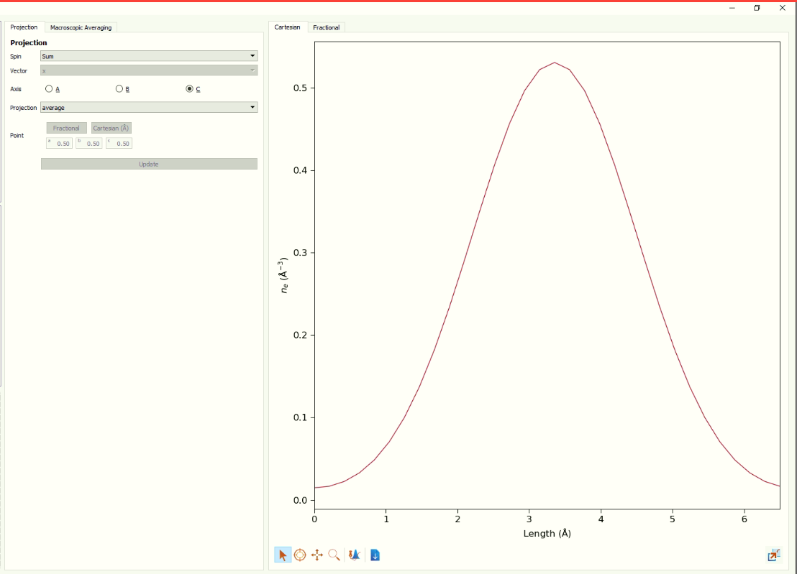
Here we can observe that there is a peak in electron density at nearly the centre, that’s because we have centred the unit cell of graphene (which has 2 atoms) at the middle(center). At the edges, there is a dip but instead of reaching zero, it has some value associated to it. This is because of the electronic interactions with the adjacent unit cell. To avoid that vacuum needs to incorporated.

Slide 7
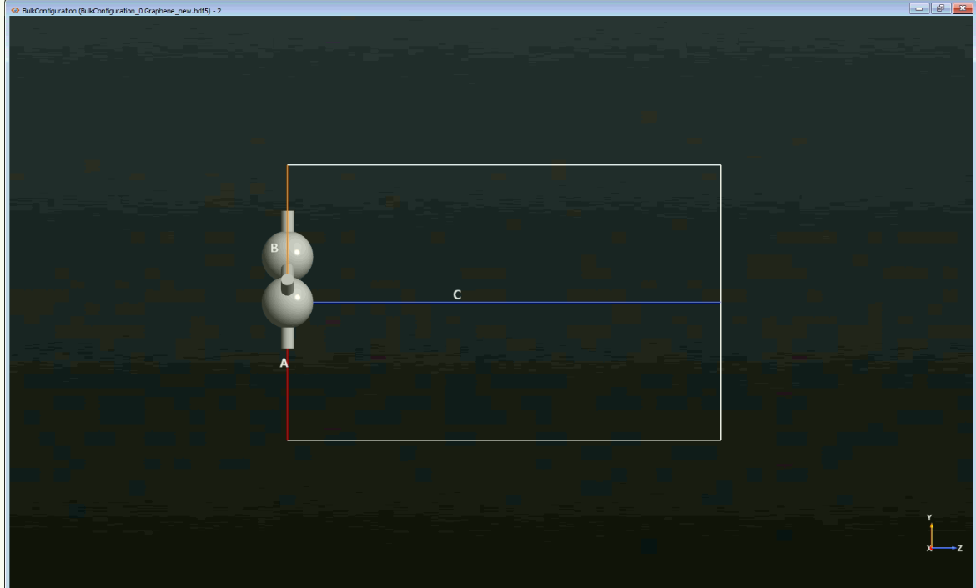
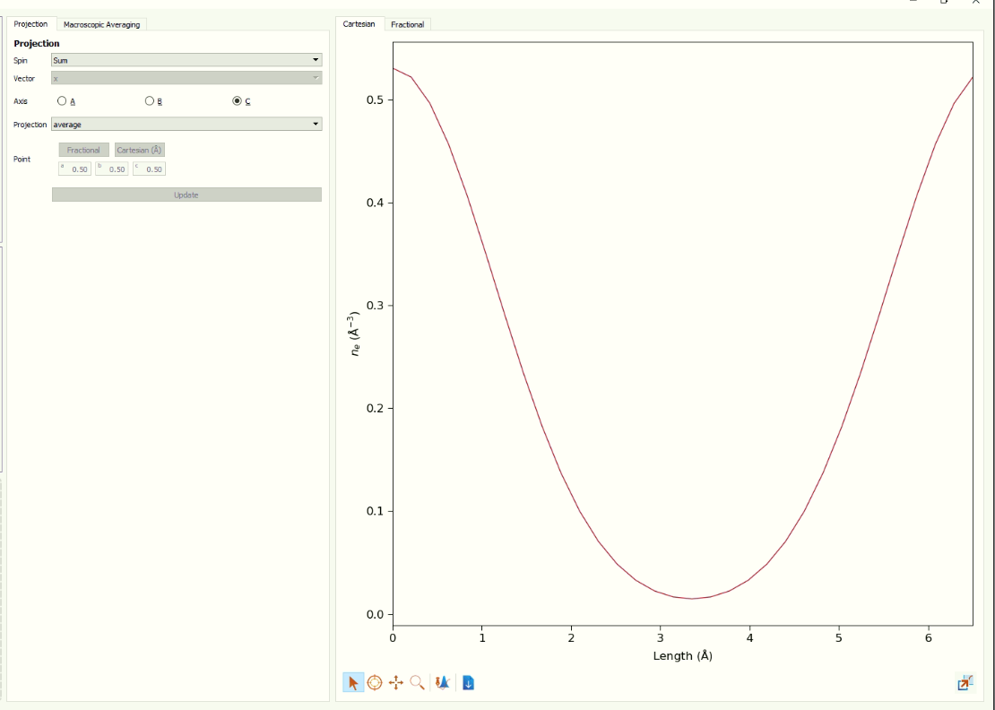
1) The peak here is shifted at the edges, unlike the previous case, that’s because the unit cell of graphene is placed at the edge, and the region where the unit cell repeats itself, there is a peak observed again. 2) The graph has a minima at the centre because there is no unit cell in the middle but it is not zero as well as it should be because of the electronic interactions with the adjacent unit cell.

Slide 8
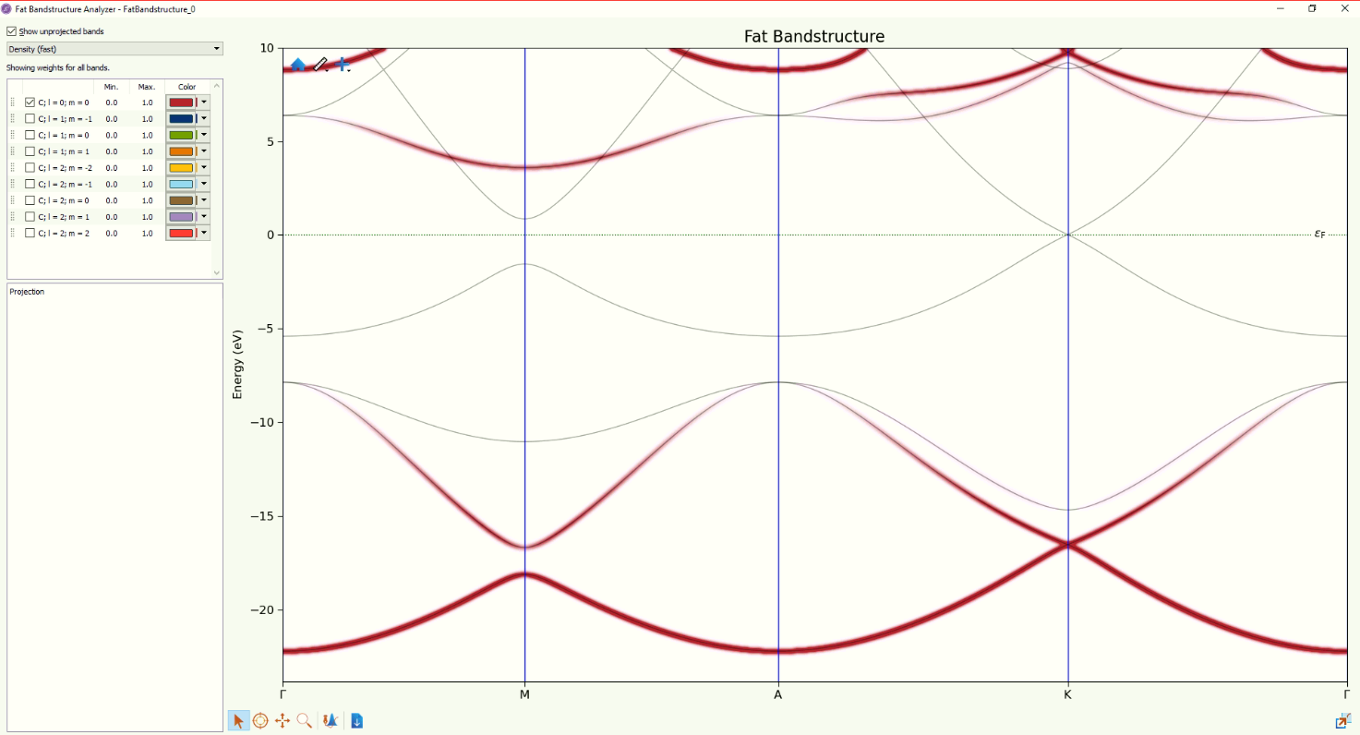
1. The graph is representing the fat band structure of graphene. 2. The shaded red region is the energy diagram of the s orbital.

Slide 9
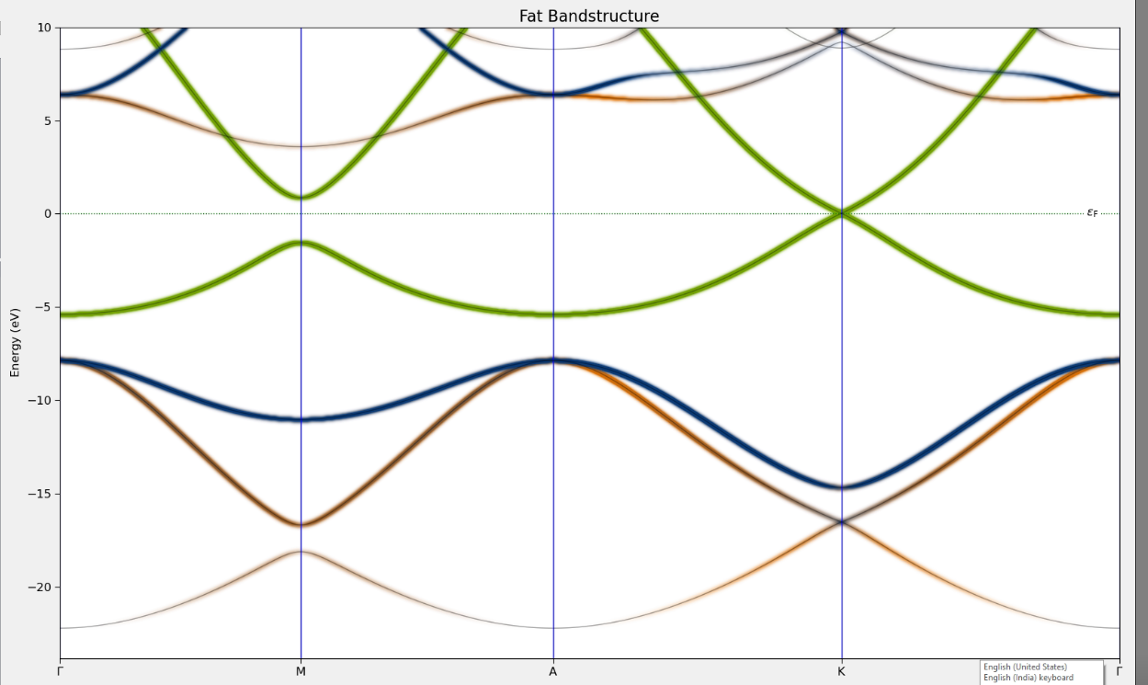
1)The green shaded region is the energy band contribution due to one of the degenerate p orbitals. 2)It has the maximum contribution in the formation of the dirac cone as; Firstly, it is marked in prominent green and also all the bands nearest to the fermi level are coloured.

Slide 10
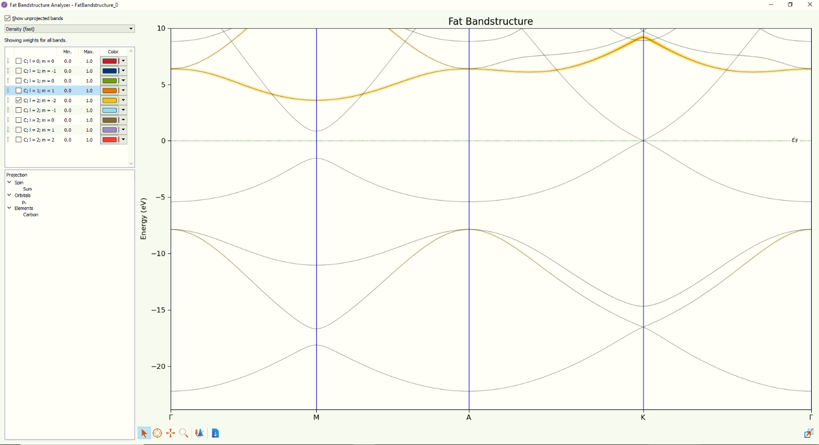
Due to d orbital which is not very significant.

Slide 11
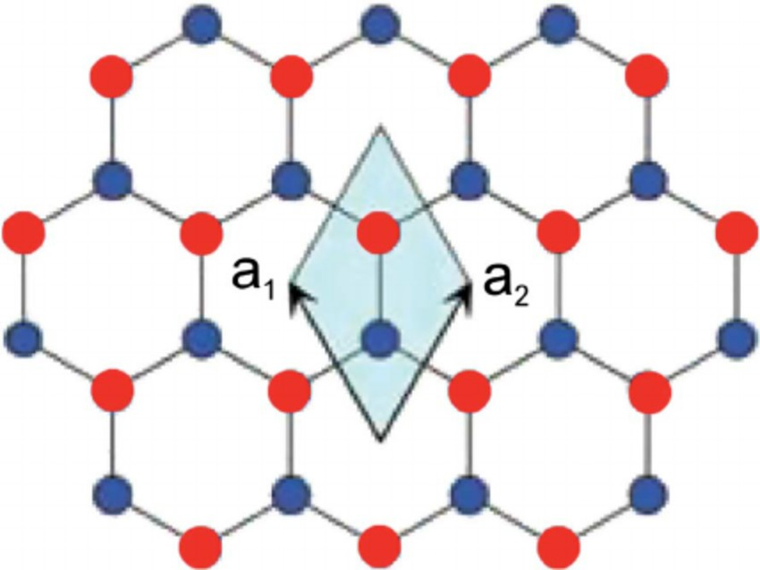
https://www.researchgate.net/figure/The-honeycomb-lattice-of-graphene-The-unit-cell-defined-by-vectors-a-1-and-a-2_fig1_51795787
The figure shows the unit cell of graphene.
The unit cell of graphene consists of 2 atoms which repeats itself in all the directions throughout the plane.

Slide 12
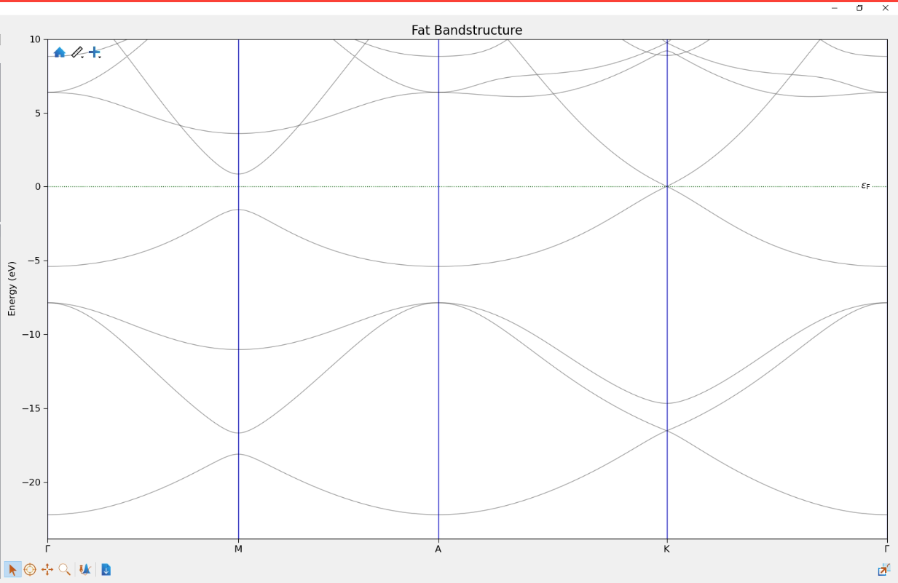

Slide 13
Band Structure Of Graphene
In the band structure of graphene, there are 8 energy bands (If we are only considering the valence electrons and the orbitals associated with them).
The electronic configuration of carbon is 1s2, 2s2, 2p2. But now we only take into consideration the valence shell electrons and not the core electrons.
Therefore, the involved orbitals are 2s, 2px, 2py and 2pz. As there are four orbitals involved with each atom, and also a unit cell has 2 atoms, we can conclude from here that the no. of energy bands would be 4*2=8.
The points on the x axis are called k points which are present in a Brillouin Zone.

Slide 14
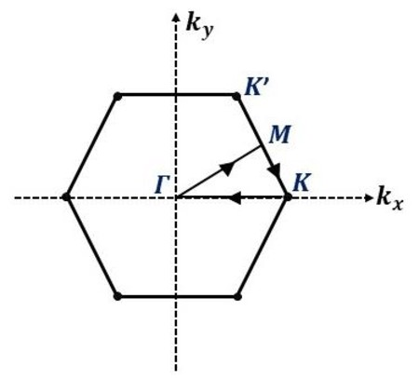
https://www.researchgate.net/figure/First-Brillouin-zone-of-graphene-crystal-structure-with-principal-direction-which-are_fig1_356665013
The primitive unit cell in the reciprocal lattice is known as the Brillouin zone.
Gamma is the centre of the Brillouin Zone.

Slide 15
Defects:-
There are 2 types of defects:-
Point defect
Line defect
Graphene has several 6 carbon rings across the 2D plane. When there are introduced rings in the sheet with size different than that of 6 membered rings, then these defects are known as point defects.
Stone wales defects are point defects. It occurs when C=C takes a 90 degrees turn in the plane breaking the 6 membered ring. Now instead of 6 membered rings, we have, two 5 membered rings and two 7 membered rings.

Slide 16
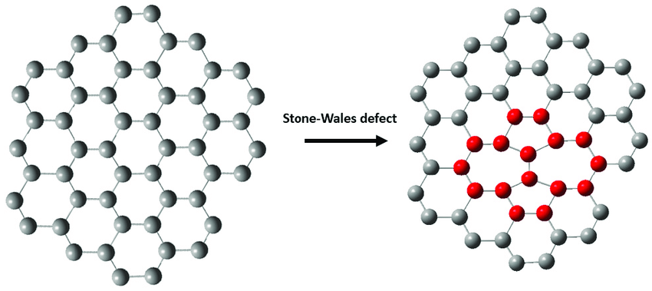
Stone wales defect
https://www.researchgate.net/figure/Stone-Wales-defect-Stone-Wales-defect_fig10_320037989

Slide 17
Definitions:-
Fermi Level:-
At absolute zero temperature the electrons arrange themselves in lowest available energy. Fermi level is the energy level above which there are no electrons. Basically, it is the surface of the sea of electrons occupying the lowest available energy.

